Slide 1
Tableau, Power Bi and Mint
By
Akash Chaudhare
19CS002
BE Comp B

Slide 2
Introduction
Tableau, Power BI, and MINT are all business intelligence (BI) tools.
Tableau was founded in 2003, Power BI in 2013, and MINT in 2004.
These tools have been designed to help organizations make data-driven decisions by transforming data into actionable insights.

Slide 3
Tableau, Power BI, and MINT offer a range of features such as data preparation, visualization, reporting, and collaboration.
Each tool has its unique strengths and weaknesses, and the choice of tool depends on the organization's needs, budget, and skill set of the users.
In this presentation, we will compare and contrast the key features of Tableau, Power BI, and MINT to help you make an informed decision on which tool is right for your organization.

Slide 4
Points of Comparison
User Friendly
Data Sources
Data Preparation
Visualization
Dashboards
Collaboration
Pricing and Licensing

Slide 5
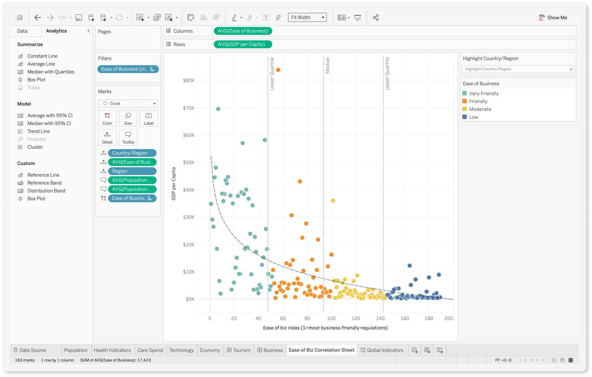
Tableau

Slide 6
Data visualization and business intelligence tool
Allows users to connect, analyze, and visualize data.
Wide range of data sources-spreadsheets, databases, cloud-based services, and big data sources like Hadoop and Spark.
Drag-and-drop interface
Interactive dashboards

Slide 7
Strong community of users
Range of products, including Tableau Desktop, Server, and Online
Different levels of functionality and flexibility.
Use scripting languages like R and Python, and build complex data models.
Steep learning curve
Robust functionality

Slide 8
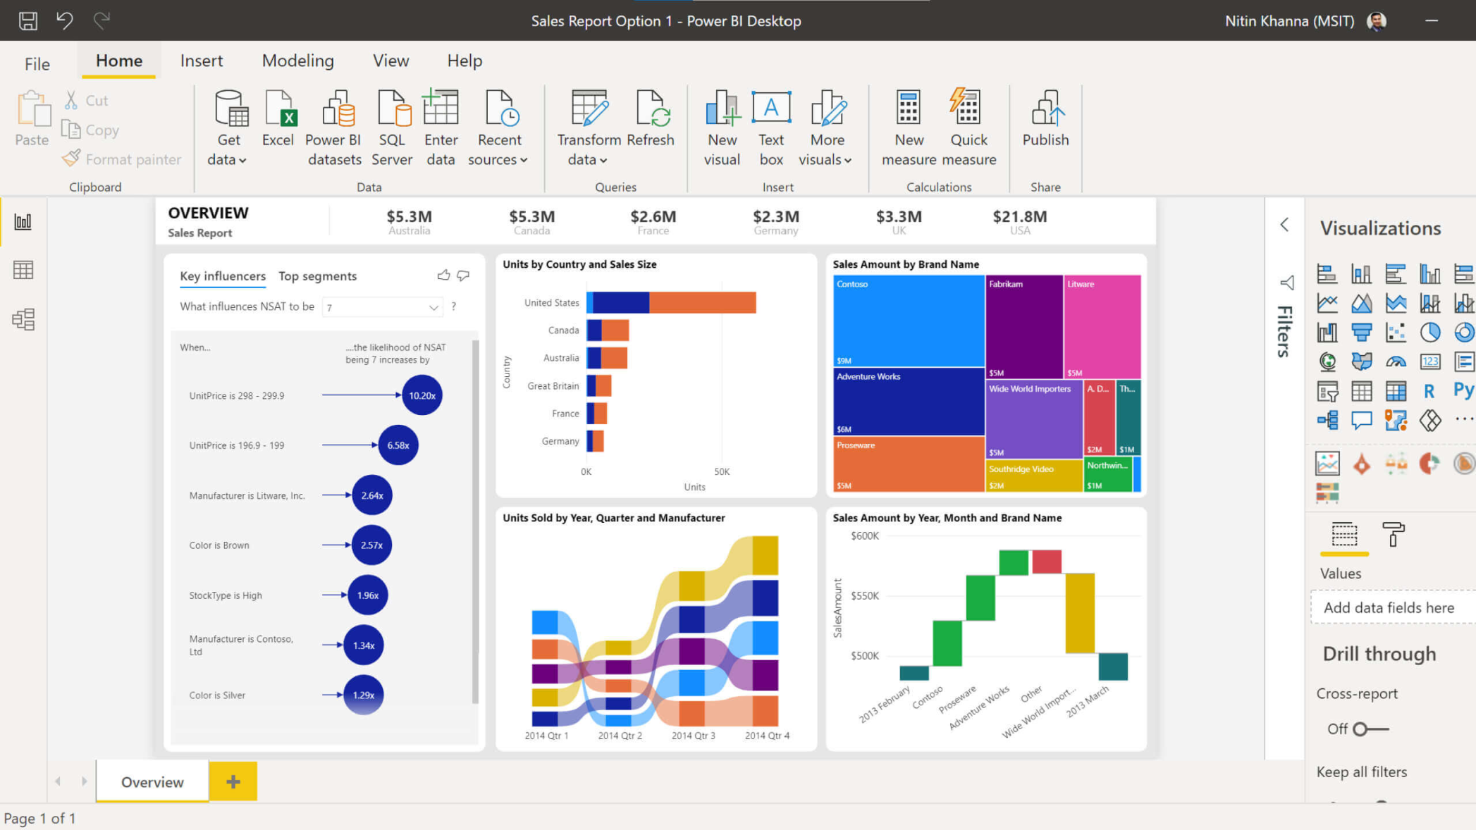
Power BI

Slide 9
User-friendly interface
DAX, a powerful formula language that enables complex calculations and data analysis.
Power BI offers a range of visualization options
Power BI offers a range of collaboration and sharing options

Slide 10
Seamlessly with other Microsoft products, such as Excel, SharePoint, and Teams, making it easy to incorporate data into existing workflows.
Power BI provides advanced analytics capabilities, such as machine learning and artificial intelligence
Power BI offers connectors for accessing data from cloud-based services like Azure and AWS,

Slide 11
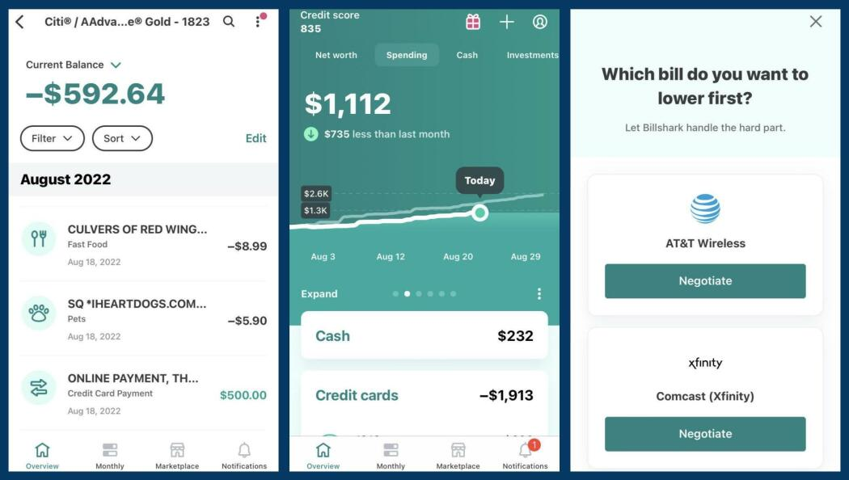
Mint

Slide 12
Cloud-based financial management tool
Track and manage their personal finances in one place.
Pulls in financial data from bank accounts, credit cards, and other financial institutions
Mint provides a dashboard that displays users' financial information
Mint offers tools for categorizing transactions and creating budgets

Slide 13
Mint provides alerts and notifications financial events
Access their financial information and manage their finances on the go.
Mint is free to use, but the platform generates revenue through targeted advertising and offers for financial products and services.
Not be suitable for users with complex financial needs or for those who are concerned about data privacy and security.

Slide 14
Results
On careful consideration of online reviews and features, we deduce the following

Slide 15
 | Tableau | Power BI | Mint
User Friendly | Least | More | Most
Data Sources | extensive support | extensive support | financial institutions and accounts
Data Preparation | powerful features | powerful features | basic
Visualization | advanced | Less advanced | basic
Dashboards | advanced | advanced | basic
Collaboration | allowing sharing reports and dashboards | allowing sharing reports and dashboards | None
Licensing | Expensive | Cheaper | Free
Specificity | Commercial BI | Commercial BI | Financial Management

